Slide 1
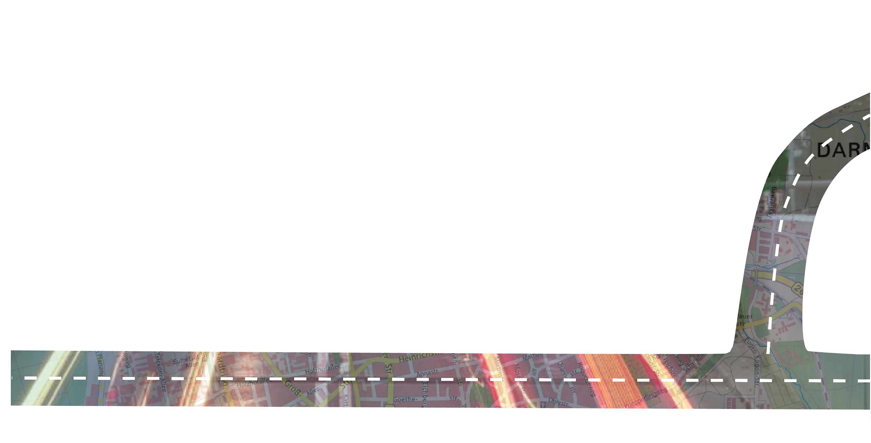

Data Science II, WS 23 / 24
T A D A
Traffic Agent DArmstadt
Data Dorks
Notes:
Tresa

Slide 2
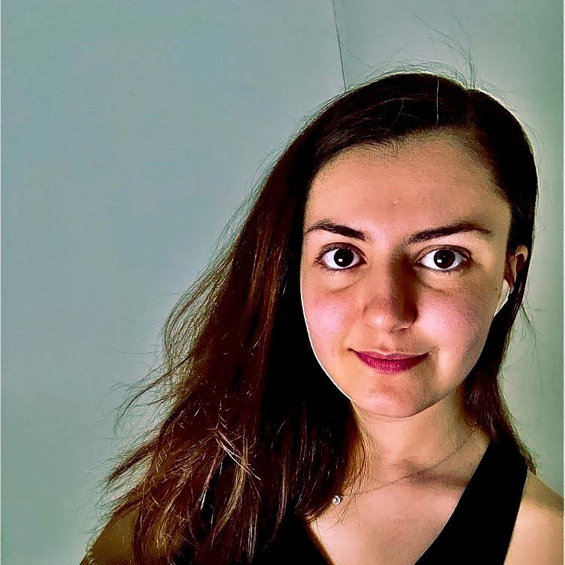



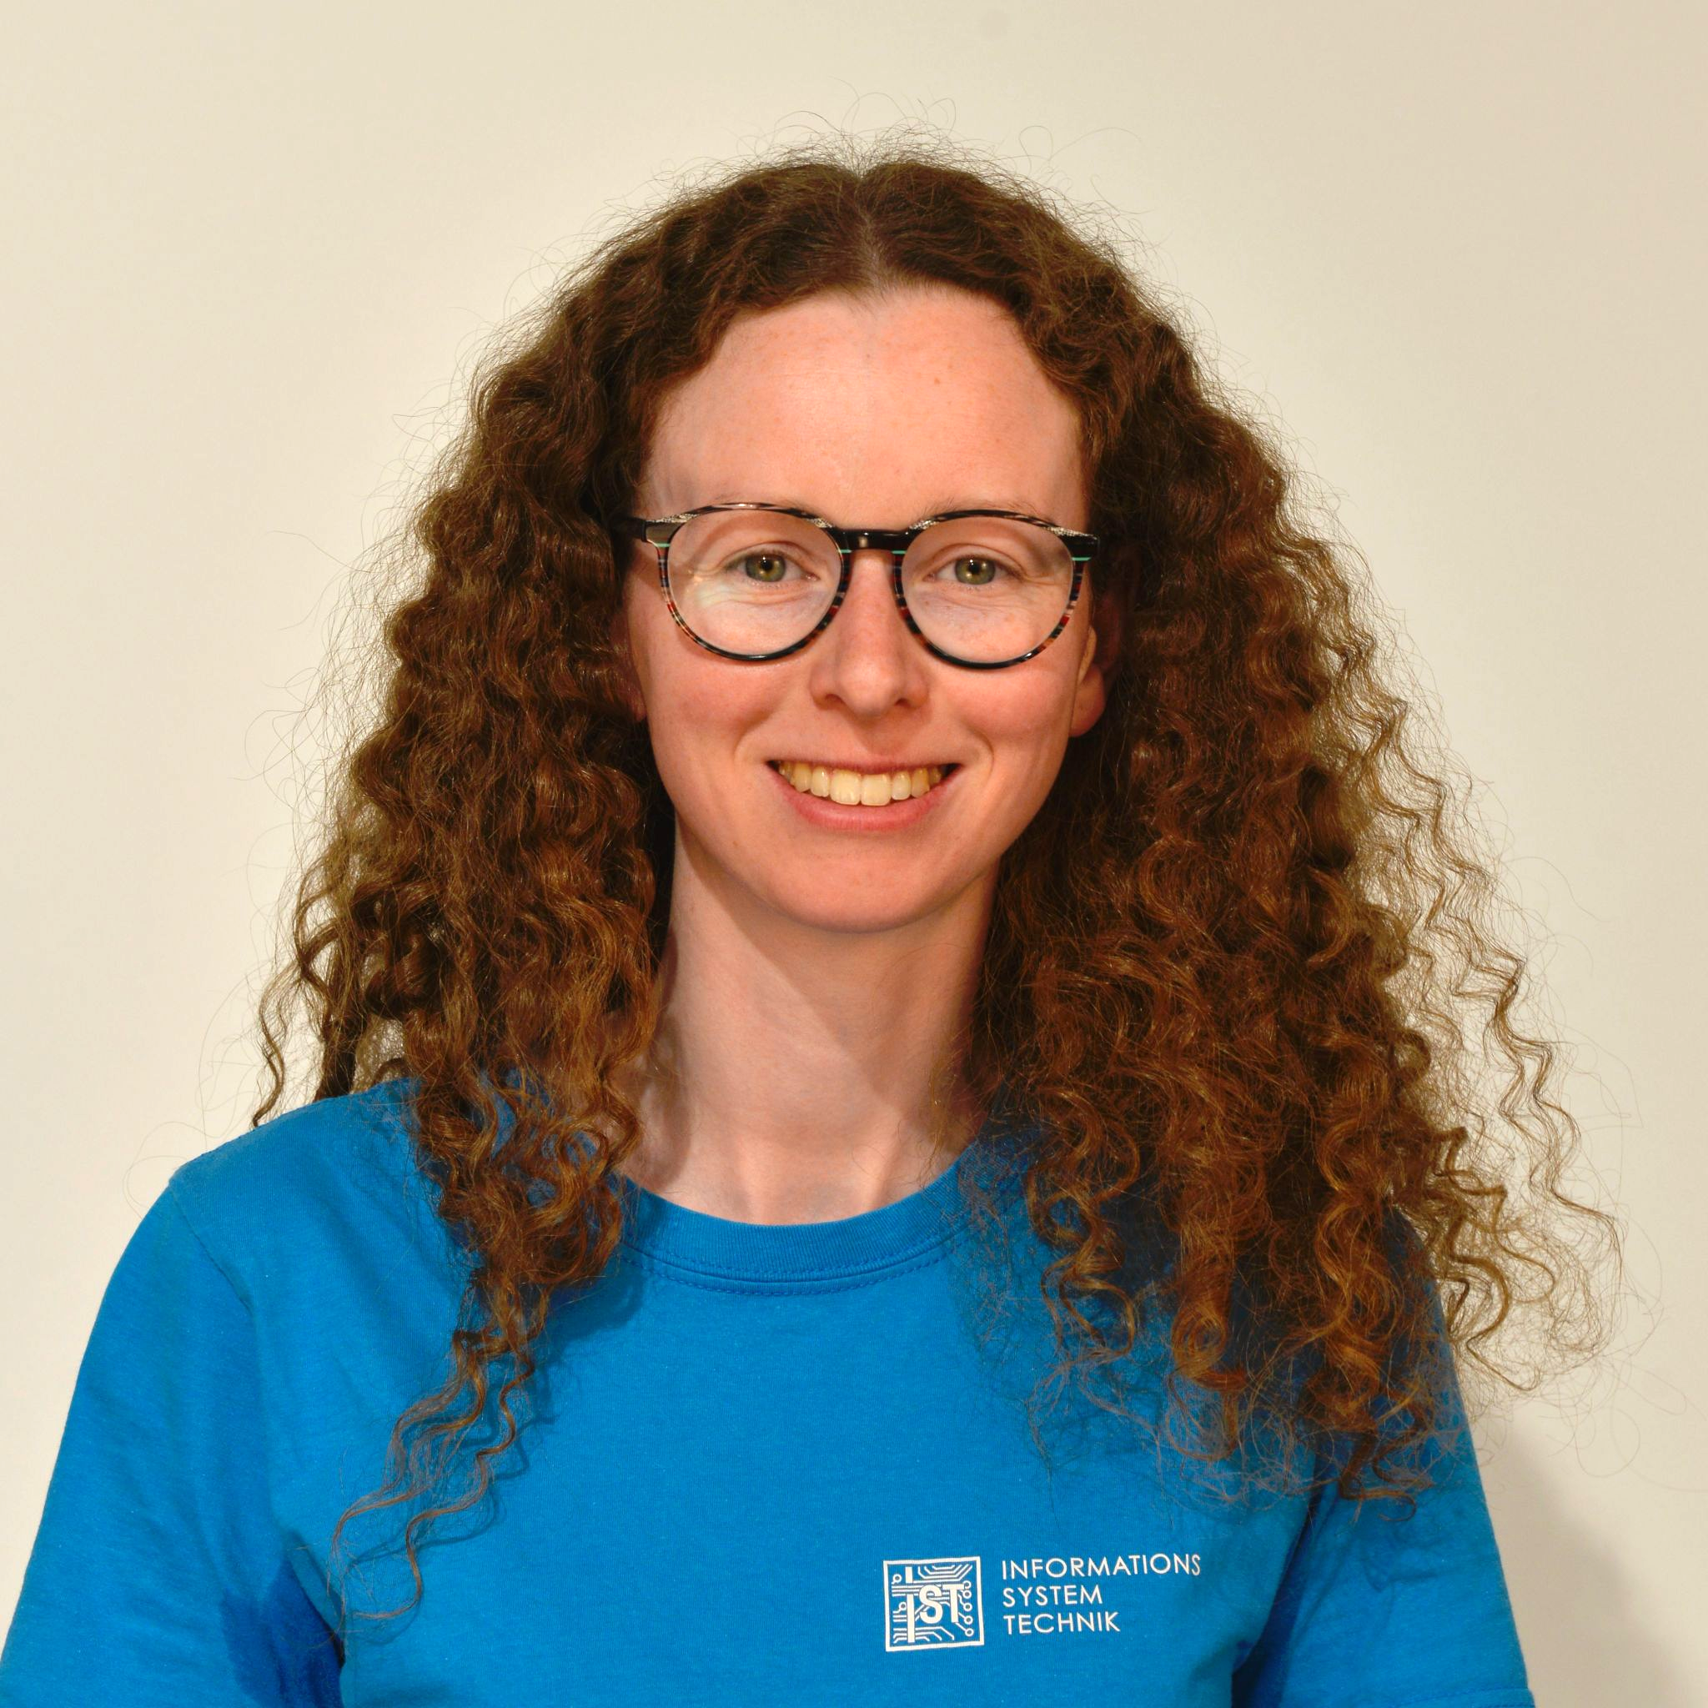

DATA DORKS
Sudhanva Sridhar Bhat
(Team Member)
Tresa Maria Joseph
(Team Member)
Dr. Olivier Boisard
(Supervisor)
Bahar Bayer (Ranjbaran)
(Team Member)
Lisabeth Maria George
(Team Member)
Nora Simon
(Team Member)
Notes:
Tresa

Slide 3
Outline
1 Problem Statement
6 Data Analysis and Interpretation
2 TADA: Traffic Agent Darmstadt
7 Model Analysis
3 Potential User
8 Technology Stack
4 Market Analysis
9 Demo
5 Business Application
10 Limitations and Future Work
Notes:
Tresa

Slide 4


Problem Statement
Notes:
Nora
Meet Bob
passionate motorcyclist, likes to tinker with the motorcycle
likes to go climbing
enthusiastic about cinema, favorite movie: Django Unchained
in contrast to his adrenaline-filled hobbies, for him, the perfect sunday evening consists of a visit to the sauna at the Jugendstilbad
Apart from his hobbies, …

Slide 5

Problem Statement
Notes:
… Bob works at the traffic department of Darmstadt
monitors traffic
analyzes congestions
plans traffic redirections for construction sites or events

Slide 6

Problem Statement
A famous scientist is visiting the university on wednesday, february 12, at 9 o'clock. How can we make sure that he arrives and leaves on time?
Is it appropriate to reroute traffic?
Notes:
One day, TU Darmstadt approaches him
“The german chancellor is coming to the university at the DATE. “
“He has a limited time schedule so he needs to arrive and depart in time”
“Will this be possible? Or do we need a short-time traffic redirection?”
Or: Sam Altmand
or: “We are planning an event with 1500 people.
-> can’t really model with specific parameters?
-

Slide 7

Problem Statement
How to make the best decision?
Usually no congestion at the time he wants
to leave on a
monday
But, for the arrival time, there will most likely be congestions.
Sometimes there’s
lots of congestion, sometimes not.
I don’t know
the pattern.
How can I be sure? Rerouting traffic is a major cut that should not be taken lightly
Notes:
How to answer the request?
Bob has quite some experience in the field
But such a specific request makes it hard for him to decide
Then his boss comes in. She wants him to make a plan how traffic could be spread over the city differently.

Slide 8


Problem Statement
How to make the best decision?
Bob, we need a plan how to optimize the traffic light signals in Darmstadt to minimize congestion. People spend too much time in traffic jams.
Usually no congestion at the time he wants
to leave on a
monday
But, for the arrival time, there will most likely be congestions.
Sometimes there’s
lots of congestion, sometimes not.
I don’t know
the pattern.
How can I be sure? Rerouting traffic is a major cut that should not be taken lightly
This would also improve air quality in Darmstadt.
Notes:
2 very different request - how to handle them without spending weeks on analyzing and controlling the traffic? (in the field?)

Slide 9

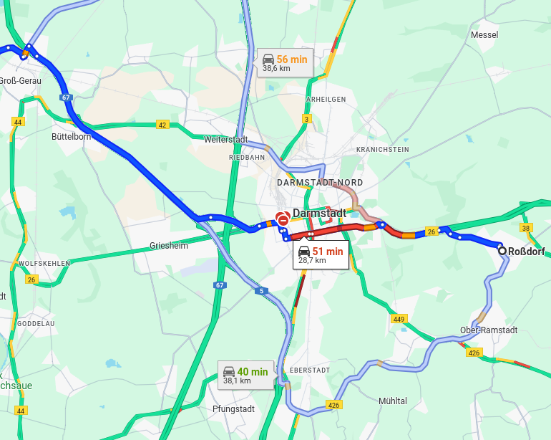
Problem Statement
I just wanted to
go from Roßdorf to Groß-Gerau, and it’s faster to drive 10km more around Darmstadt to get there.
Notes:
Then his boss comes in. She wants him to make a plan how traffic could be spread over the city differently.
2 very different request - how to handle them without spending weeks on analyzing and controlling the traffic? (in the field?)

Slide 10
Problem Statement
How to
find an optimal solution?
“We”
I believe we can solve this problem
How to
deal with the Scientist visit?
Notes:
Bob feels a bit overrun by his boss, but he understands her frustration. After all, it’s their job to improve the traffic situation in Darmstadt.
Bob thinks about these 2 very different request - how to handle them without spending weeks on analyzing and controlling the traffic? (in the field?)
How can he find an optimal solution?
Well, worry no longer, because this is where we step in:

Slide 11



TADA:
Traffic Agent DArmstadt
Identify critical junctions early on before congestion occurs
Balance traffic by controlling traffic light signals
Analyse traffic over long term to improve traffic concepts
Precisely plan traffic at specific times
Notes:
What the TADA application does:
Uses its own sensor data derived from the data platform of Darmstadt
implements machine learning algorithms
makes precise predictions for traffic data
this application allows the users to:
identify the most important junctions in time before congestion on the road
potentially change traffic light signals thus creating a more balanced traffic on the road
perform long-term analysis of traffic data for better results
plan their routes at precise times that they choose

Slide 12










Potential Users
Notes:
Basically interesting for everyone who uses traffic and everyone who works with it
control center agent monitoring and controlling traffic
recognize and plan critical situations
road users and residents
city planners, road planning department from the Mobility and Civil Engineering Office (traffic planning and management), construction workers on the road
students from Traffic and Transport Master program
in general, all civilians using the city transportation network to travel from one point to another

Slide 13


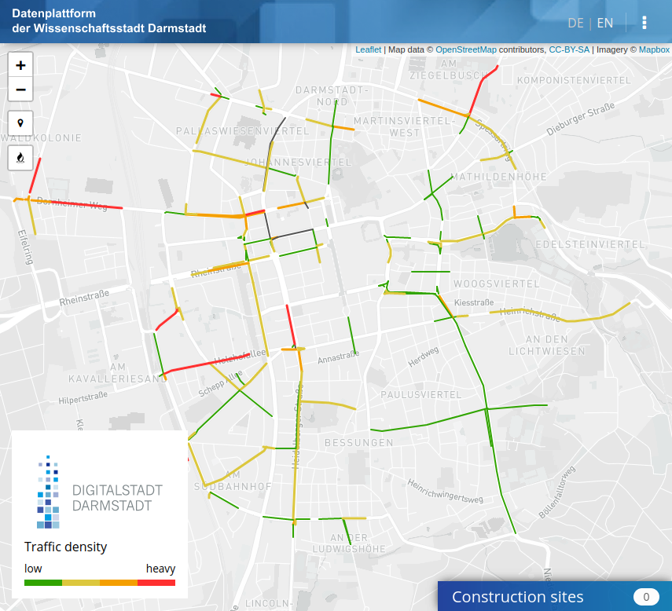
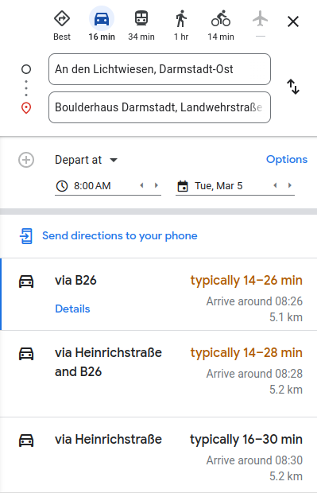
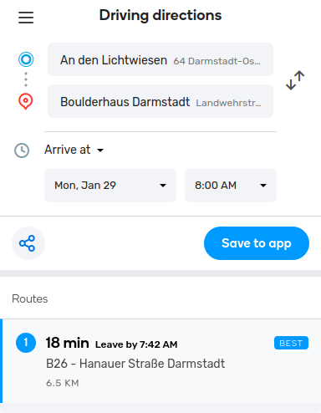
Market Analysis
Traffic user interface of Datenplattform Darmstadt
Route prediction with Google Maps
Route prediction with Waze
Use of Internal sensor data
No prediction
No navigation
No Internal sensor data
Imprecise prediction
No Internal sensor data
Prediction: seven days
Notes:
We need a tool that uses own sensor data so as to create accurate predictions to model future traffic and improve the traffic situation in Darmstadt.
internal user data = sensor data from the Darmstadt traffic platform
Google Maps and Waze don’t use road sensor data and their prediction is not exact, especially as we look further into the long-term future.
however, comparing Google maps and our application in more detail is out of the scope of this project.
-> Our application is a combination of all these 3 applications because it uses directly the traffic data specifically for Darmstadt and we are able to select on which date and time in particular we would like to predict the traffic in the city

Slide 14


Business Application
?
Machine Learning?
Data is publicly available
Bob could read it out himself
Very complex, high hurdle if in-depth data science and Programming knowledge is lacking
TADA
Intuitive user interface
Extendable
indirect positive effects
improvement of air quality
increased safety
EDA?
Notes:
Lisa
Who would buy the app?
Data is publicly available, Bob could read it out himself
need an app -> Frontend
picture of Bob trying to code himself and failing -> solution: our application (Tada!)

Slide 15
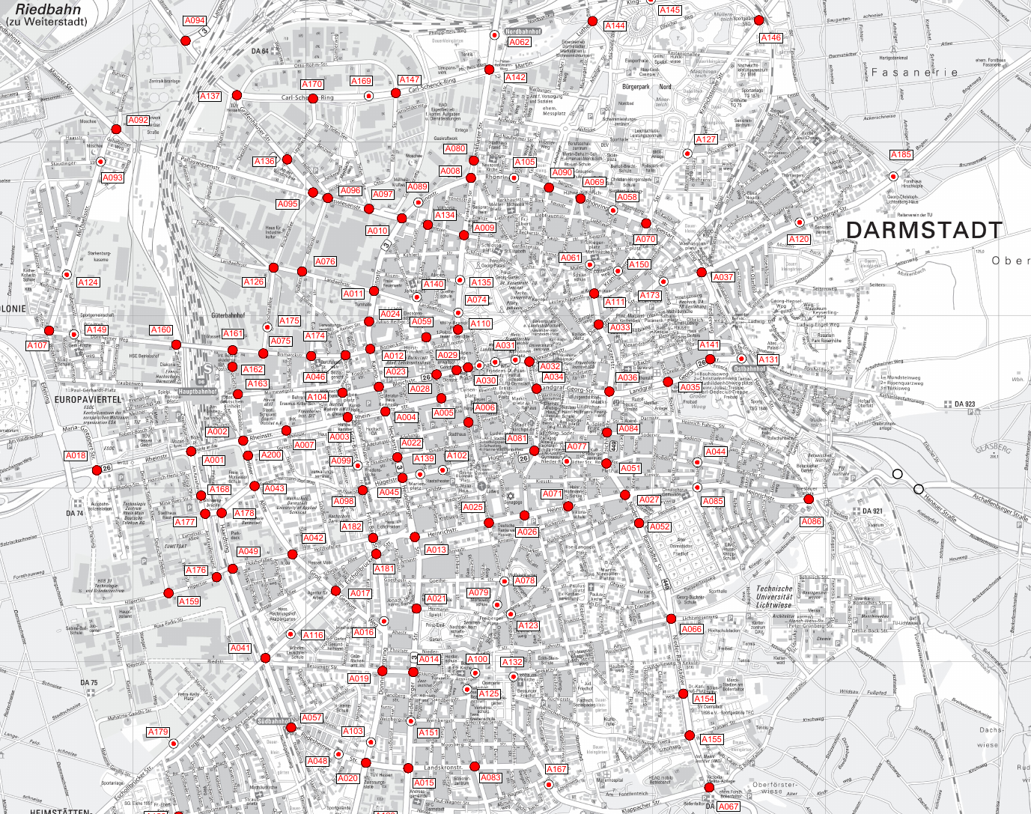
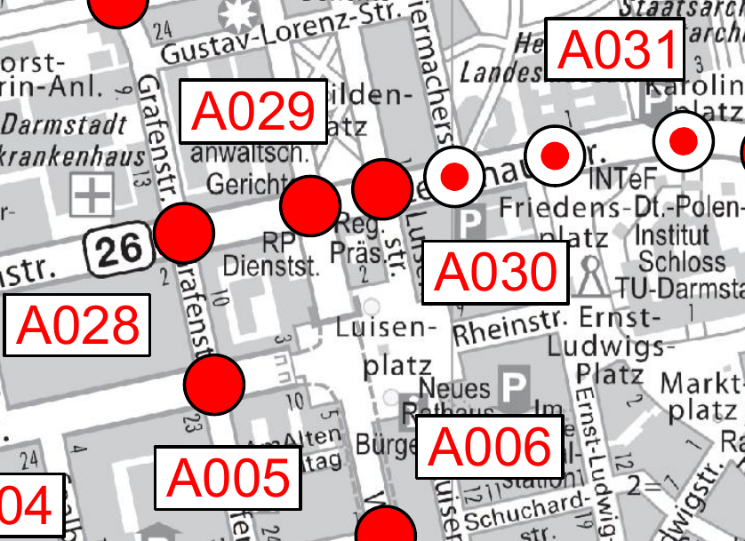
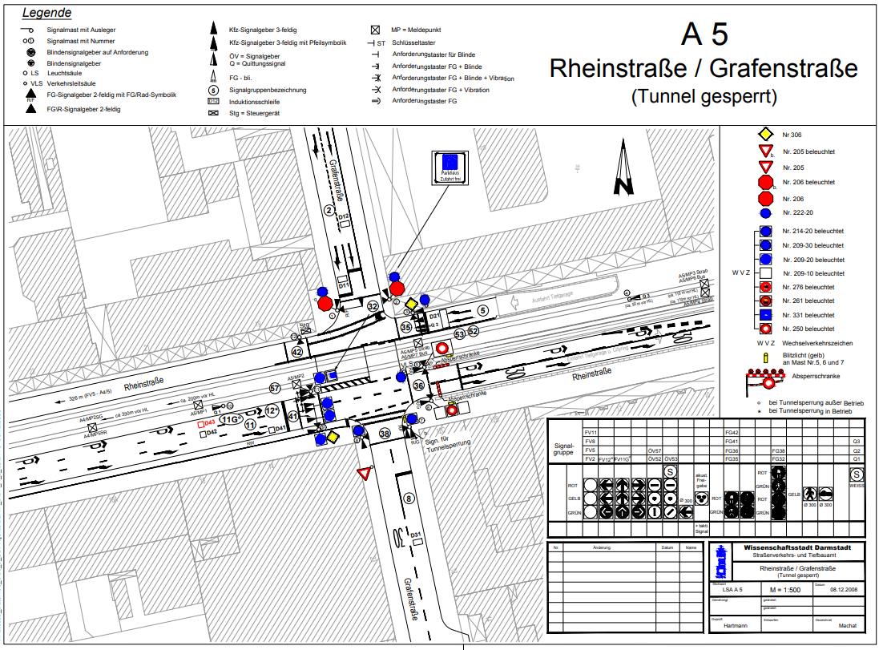
Data Analysis and Interpretation
Data acquisition at 152 junctions
Different sensors for motor vehicles, pedestrians and public transport
Induction loops and video detectors most common
Traffic counts at specific timestep
Recording since May 2021 to May 2023
Minimum Viable Product
5 junctions in the center of Darmstadt
Focus on motor traffic
Overview of traffic light systems with detectors from Datenplattform Darmstadt

Slide 16
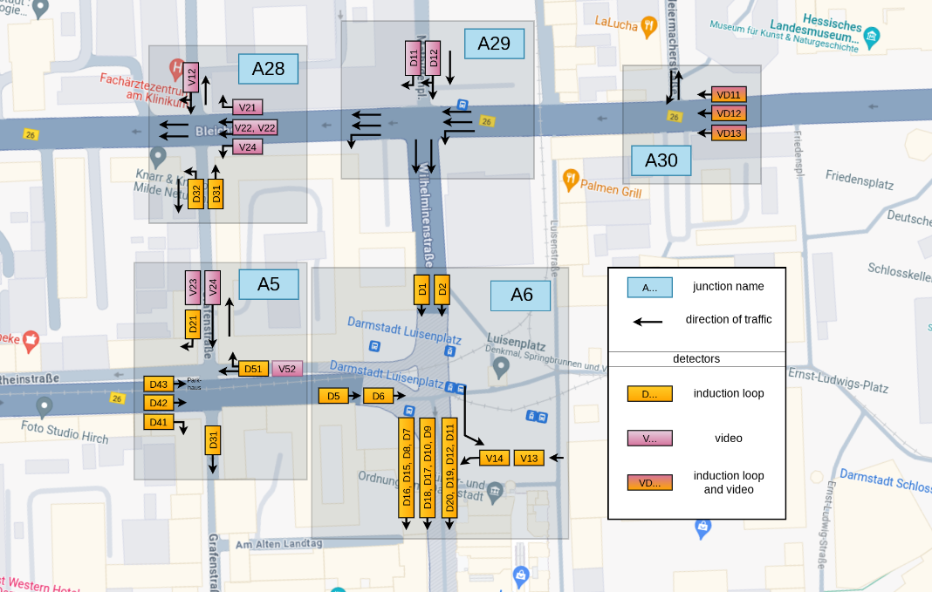
Data Analysis and Interpretation
Motor traffic detectors at junctions A5, A6, A28, A29 and A30 (sketch, not to scale)
Notes:
Bahar
here are our junctions with their corresponding sensors: some junctions underground, some not
each junctions has very different amount of sensor data
-> A6 has many sensors, A29 only 2. Our priority was to find the target variable, so we chose one critical sensor for each junction.
On top, data of A29 not reliable, 100% of the data values was zeros. (problem with this junction is later discussed in the demo) There was a construction site.
decide how we came up with the sensor for each junction: Luisenplatz is one of the most important locations in Darmstadt so we chose 5 junctions around it
Talk about need to hard-code position of sensors: we handpicked all the sensors we needed from the map and did some pre-processing (We removed all null columns and split the datetime into the elements that we required to train the model(for example, the year, month, time of day etc)) to figure out the target variable. So to identify the target variable and detailed analysis, we made the following plots:

Slide 17
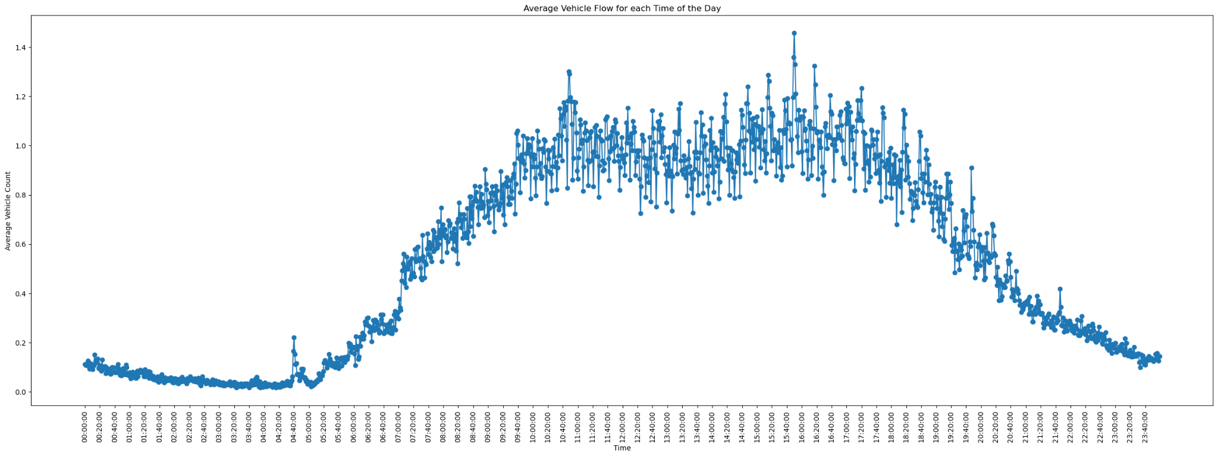
Data Analysis and Interpretation
Notes:
Sudhanva
Time Series Data
-> look for seasonality
some junctions don’t work the way we want
missing sensors, sensors marked in map not in dataset and vice versa
sensor data = zero -> construction sites?

Slide 18
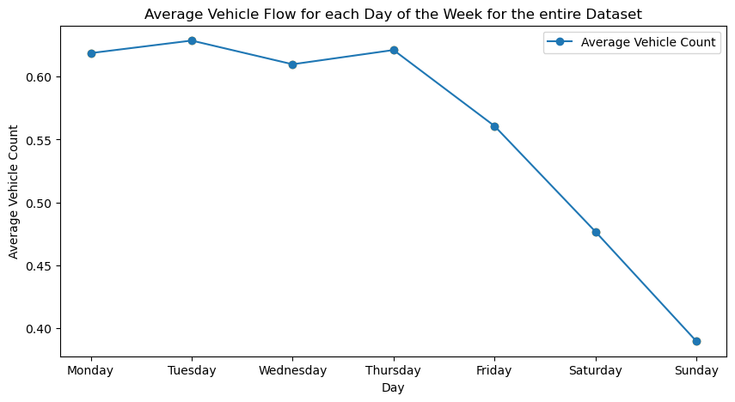
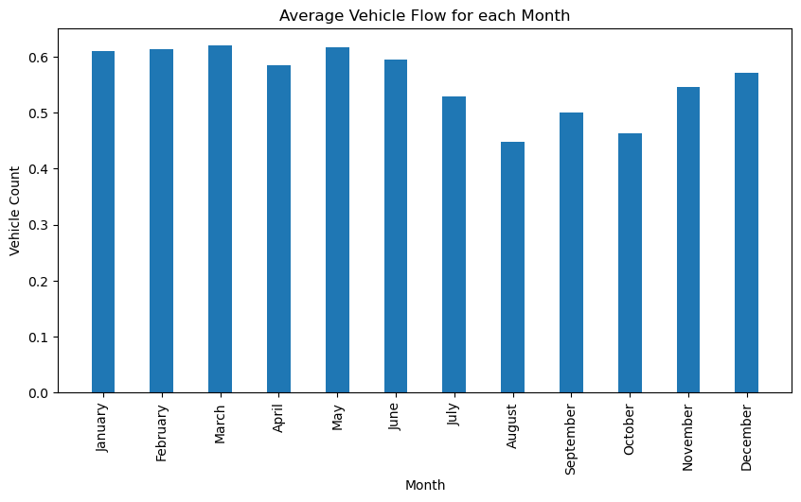
Data Analysis and Interpretation
Notes:
There is some moderator variable in summer
-> educated guess: weather/ temperature, weekends/ weekdays/ holidays

Slide 19
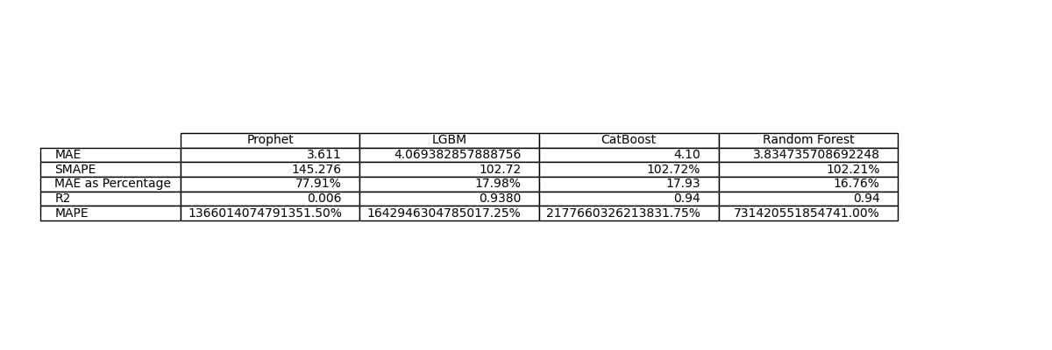




Model
Time-series traffic data prediction: Predict the number of cars per hour
Suitable models include LSTM, ARIMA, Prophet, Random Forest, LightGBM and CatBoost
 | MAE (Mean Absolute Error) | R² (Coefficient of Determination) | SMAPE (Symmetric Mean Absolute Percentage Error)
Prophet | 3.611 | - | -
Random Forest | 3.834 | 0.94 | 102.21
LightGBM | 4.069 | 0.938 | 102.72
CatBoost | 4.10 | 0.94 | 102.72
not usable if predicted value is 0
Model comparison metrics
sklearn-metrics not applicable to Prophet
Notes:
Nora
research -> Suitable models for time-series data
LSTM (Long Short-Term Memory), ARIMA (AutoRegressive Integrated Moving Average)
Decide to compare Prophet, LightGBM, CatBoost and RandomForest
(based on research and supervisors advice)
Prophet
from Facebook
additive time series forecasting model
optimized for time series that have strong seasonal effects and several seasons of historical data
RandomForest
ensemble learning method
combines the output of multiple decision trees to reach a single result
Boosting techniques train single tree using a sequence of underfit trees. There are different boosting methods.
LightGBM
originally developed by Microsoft
gradient boosting framework
uses Gradient-based one-side sampling (GOSS) to fastly find most influential cuts
(only use instances with large gradients and cut smallest gradients when sampling the dataset)
Exclusive Feature Bundling (EFB) for reducing the number of features
grows trees by leaves -> can create asymmetric trees
very fast
CatBoost
developed by Yandex (russian internet search engine)
gradient boosting on decision trees
uses ordered Boosting and ordered Test Statistics
minimal variance sampling (MVS) helps to maximize accuracy of splits
optimized for categorical features
grows trees by levels and builds balanced trees
Present some of the metrics we used
prophet -> strange results when calculating metrics
needs to be evaluated differently
own metrics hard to use for comparison
SMAPE: whenever actual or predicted value is 0, SMAPE automatically hits the upper boundary value
Prophet less flexible, difficult to modify
Models similar in terms of performance
Random Forest: well-known, directly integrated with scikit-learn library
MAE: Mean Absolute Error = 1( sum(y-y_pred))/number of datapoints
same unit (-> easy to interpret)
robust to outliers (->greater errors are not penalized more heavy)
has to be compared to scale of target variable!
R²: 1- RSS/TSS, RSS: sum of residual squares, TSS: total sum of squares.
→ how much of data variation can be explained by your model
the closer RSS to 1, the better the residual error
0: model does not predict the outcome
1: model perfectly predicts outcome
SMAPE: SMAPE = (1/n) * Σ(|forecast – actual| / ((|actual| + |forecast|)/2) * 100
the smaller the value for SMAPE the better the predictive accuracy of a given model.
A limitation to SMAPE is that if the actual value or forecast value is 0, the value of error will boom up to the upper-limit of error.
Advantages: its ability to handle zero values and its symmetry, which ensures that overestimation and underestimation errors are treated equally
Disadvantages: It is sensitive to extreme outliers as the percentage difference is calculated. It can produce infinite values if the actual and predicted values are both zero.

Slide 20
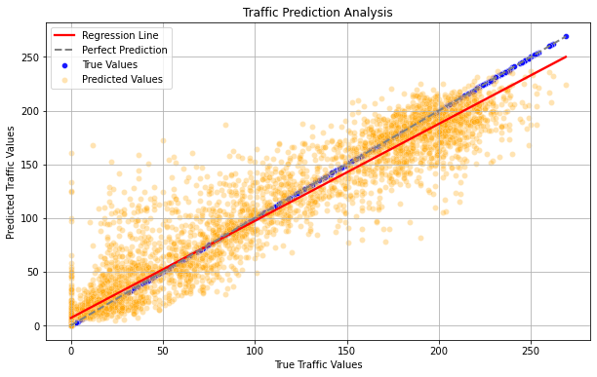
Random Forest
Notes:
Lisa

Slide 21
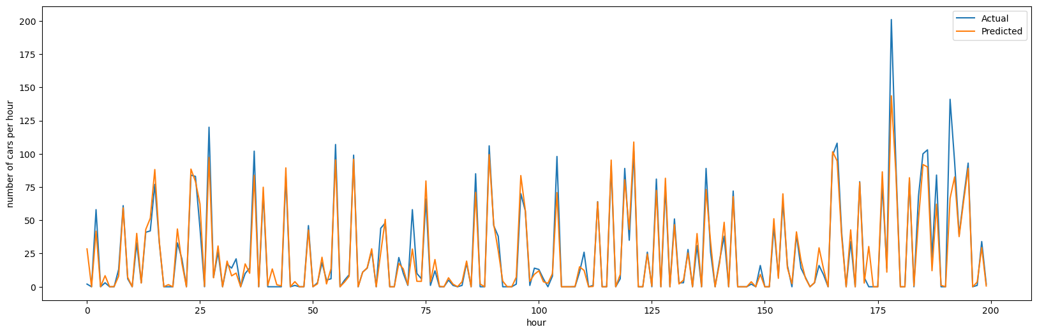
Random Forest
Random Forest: first 200 predicted and actual values
Notes:
Lisa

Slide 22
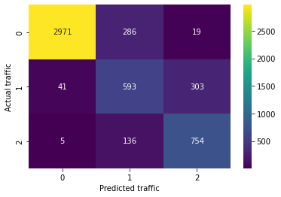
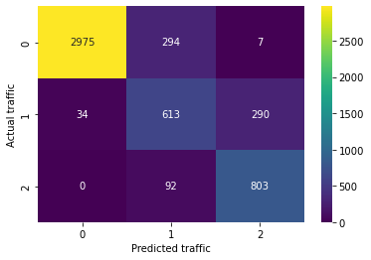
Random Forest Evaluation
How to evaluate the model?
Use metrics from scikit-learn
Hyperparameter tuning:
Basic model performs best
Comparison using Confusion Matrix
confusion matrix of hyper-parameter tuned model
Cross validation tricky with time-series data
Cannot mix past and future
Not possible to use cross-validation from libraries
confusion matrix of Random Forest model

Slide 23
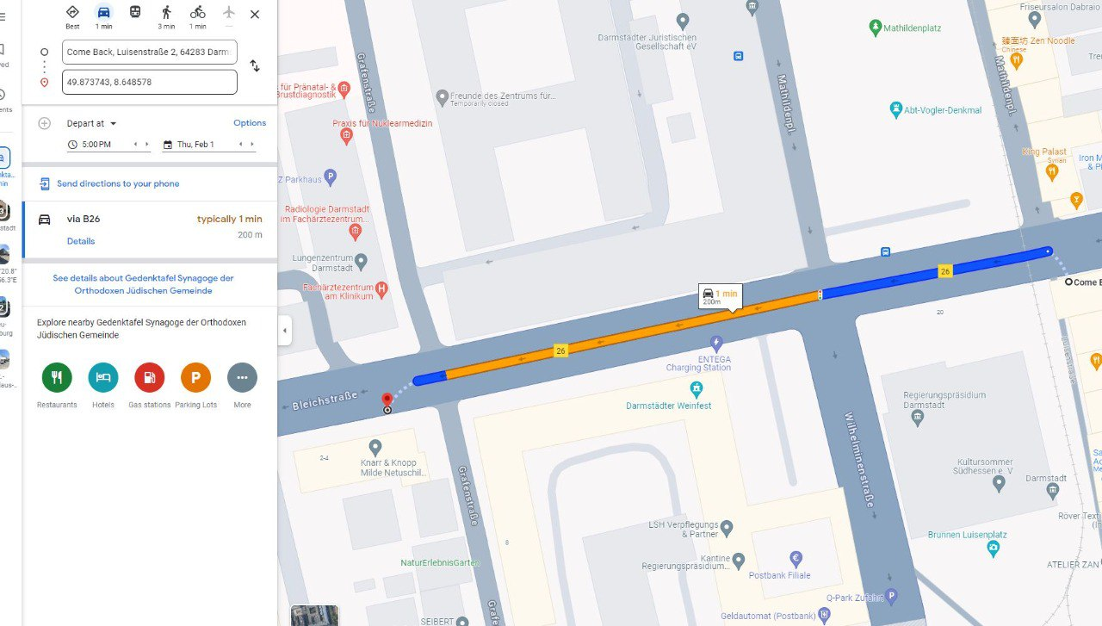
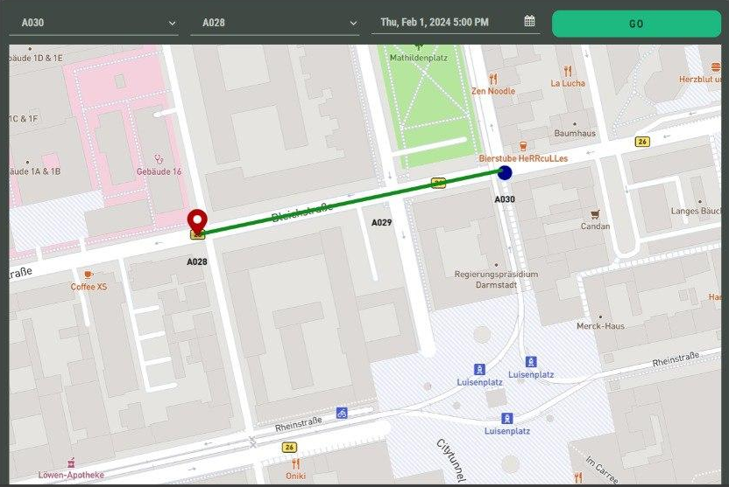
Sample: Comparing Google Maps and TADA
Data predicted for 1st February 2024, 17:00 by google and TADA
Google Maps congestion prediction for 1st February at 5 pm
TADA congestion prediction for 1st February at 5 pm

Slide 24
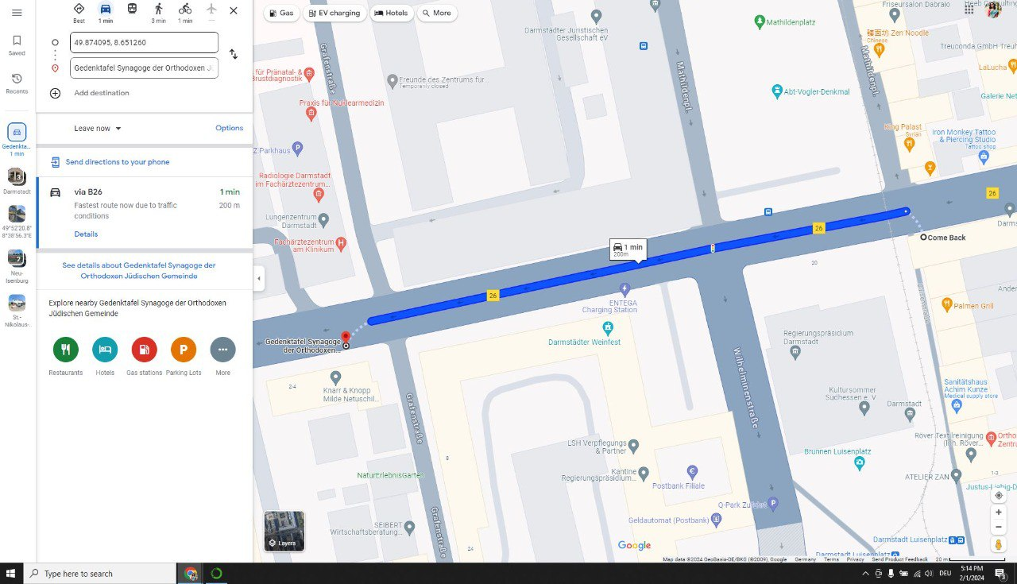
Sample: Result
Actual data on 1st February 2024, 17:00
Google Maps congestion at 1st February at 5 pm
Notes:
Sudhanva

Slide 25


From model to application
Notes:
Bahar
Bob was quite confused with technical terms that were unfamiliar to him like python, EDA, machine learning
that’s why we decided to implement a user-friendly application
so the following technology stack is how we created an application for traffic data which is easy to use for a common person like Bob:

Slide 26












Technology Stack
Project Management
Development
Backend
Frontend
Notes:
Lisa

Slide 27
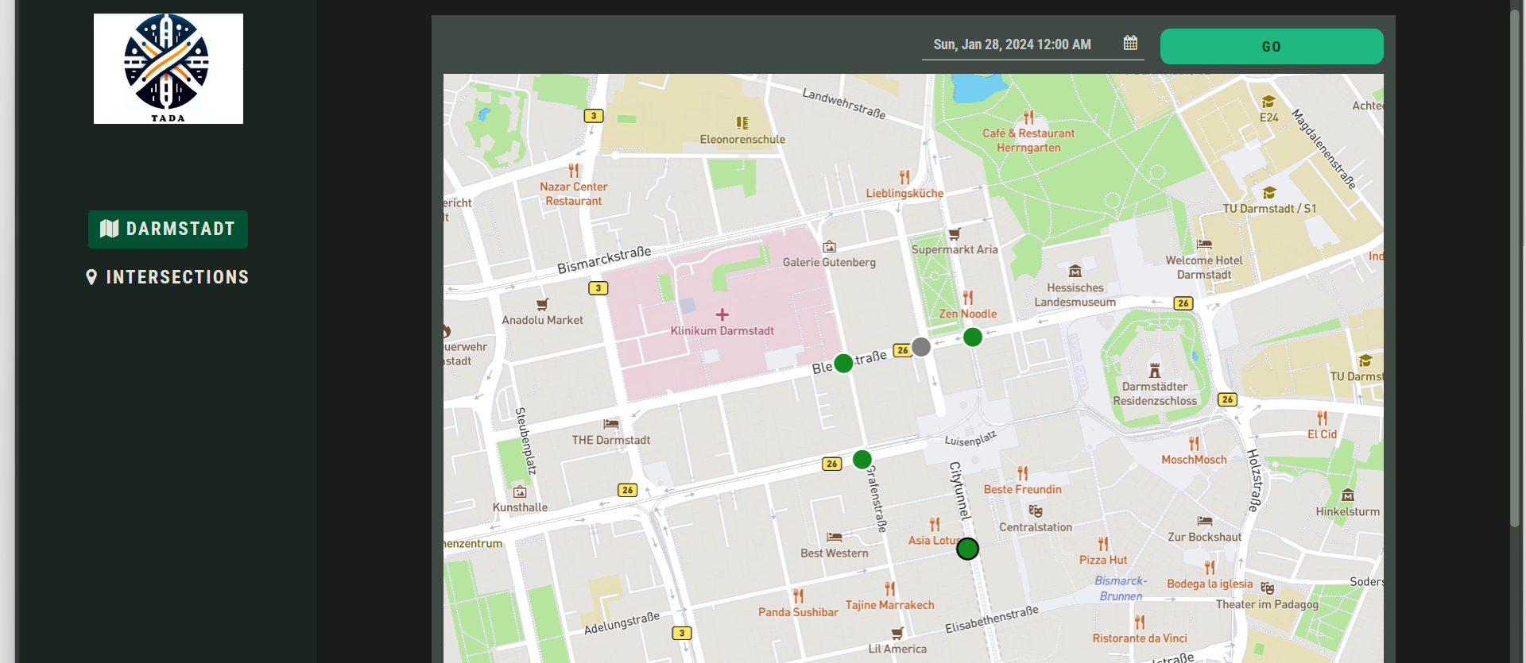
Demo
Notes:
Tresa

Slide 28

Would you use it?
This helps me in improving the traffic situation!
Definitely!
Notes:
Nora
So, what do you think: would Bob like to use this application? Let’s ask him.
He definitely would.
Thanks for the approval.
But let’s not forget to talk about the limitations we encountered

Slide 29
Limitations
Implementation restricted to selected junctions at the moment.
Real time data integration.
No regular pattern in junction design and placement of sensors.
Assumptions and simplifications made in the predictive models may lead to variations in real-world scenarios.
Model Limitation: Climate factors are not accounted for in this analysis.
The model may struggle to account for sudden and unexpected events that were not present in historical data.
Notes:
Sudhanva
https://medium.com/@soumyachess1496/cross-validation-in-time-series-566ae4981ce4

Slide 30
Future Work & Improvements
Integration of wider regions - Eberstadt, Dieburg, Griesheim and Pfungstadt. Even the whole of Germany.
Predicting alternate route with lesser traffic. Better route to transport from A to B.
Automating the process - as regions added.
Real time Data Integration.
Collaboration with local authorities for further development strategies.
Utilizing the multiple sensors per junctions.
Adding prediction confidence level.
Improve model performance by hyperparameter tuning
Notes:
If we could fetch the data via API call from the data platform of Darmstadt in real-time and combine it with an up-to-date JSON file of each junction, then real-time data integration would be possible. At the moment this is not possible because we had to manually hand-pick the target variable.
Prediction confidence level based on the chosen implemented model.

Slide 31
Thank you!
Questions are Welcome

Slide 32
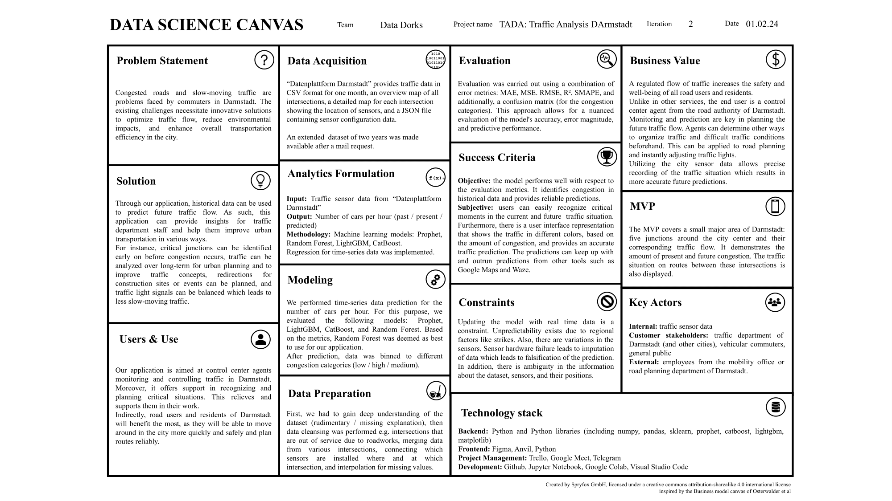

Slide 33
Image Sources
Datenplattform Darmstadt:
Traffic user interface: https://datenplattform.darmstadt.de/#!/map/trafficCongestion
open traffic data (dataset, junction plans from slide 15) : https://datenplattform.darmstadt.de/verkehr/apps/opendata/#/
other navigation tools
https://www.google.de/maps
https://www.waze.com/live-map/
logos have been taken from the corresponding vendor homepage
icons:
<a href="https://www.flaticon.com/free-icons/machine-learning" title="machine learning icons">Machine learning icons created by VectorPortal - Flaticon</a>
<a href="https://www.flaticon.com/free-icons/sensor" title="sensor icons">Sensor icons created by Freepik - Flaticon</a>
<a href="https://www.flaticon.com/free-icons/forecast" title="forecast icons">Forecast icons created by Parzival’ 1997 - Flaticon</a>
<a href="https://www.flaticon.com/free-icons/female" title="female icons">Female icons created by juicy_fish - Flaticon</a>
<a href="https://www.flaticon.com/free-icons/bus" title="bus icons">Bus icons created by Freepik - Flaticon</a>
<a href="https://www.flaticon.com/free-icons/bus" title="bus icons">Bus icons created by kumakamu - Flaticon</a>
<a href="https://www.flaticon.com/free-icons/architect" title="architect icons">Architect icons created by khld939 - Flaticon</a>
<a href="https://www.flaticon.com/free-icons/car" title="car icons">Car icons created by Kiranshastry - Flaticon</a>

Slide 34
Backup slides

Slide 35
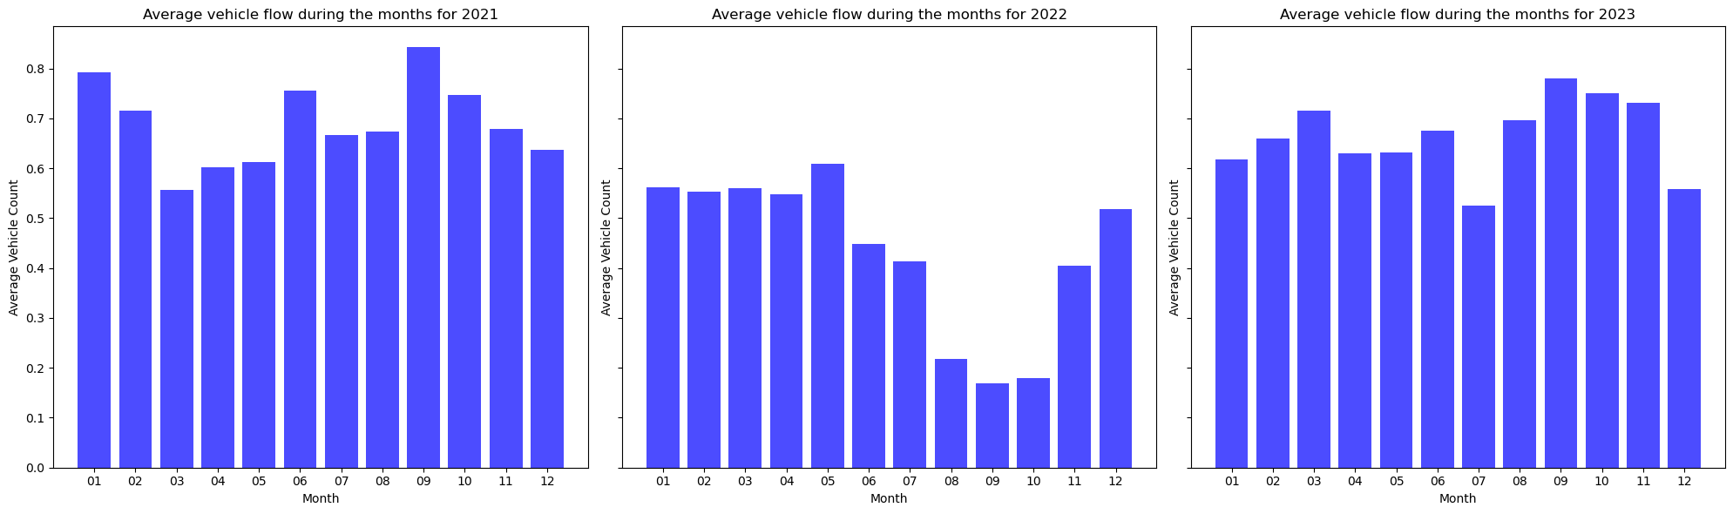
EDA plots
average vehicle flow per year

Slide 36
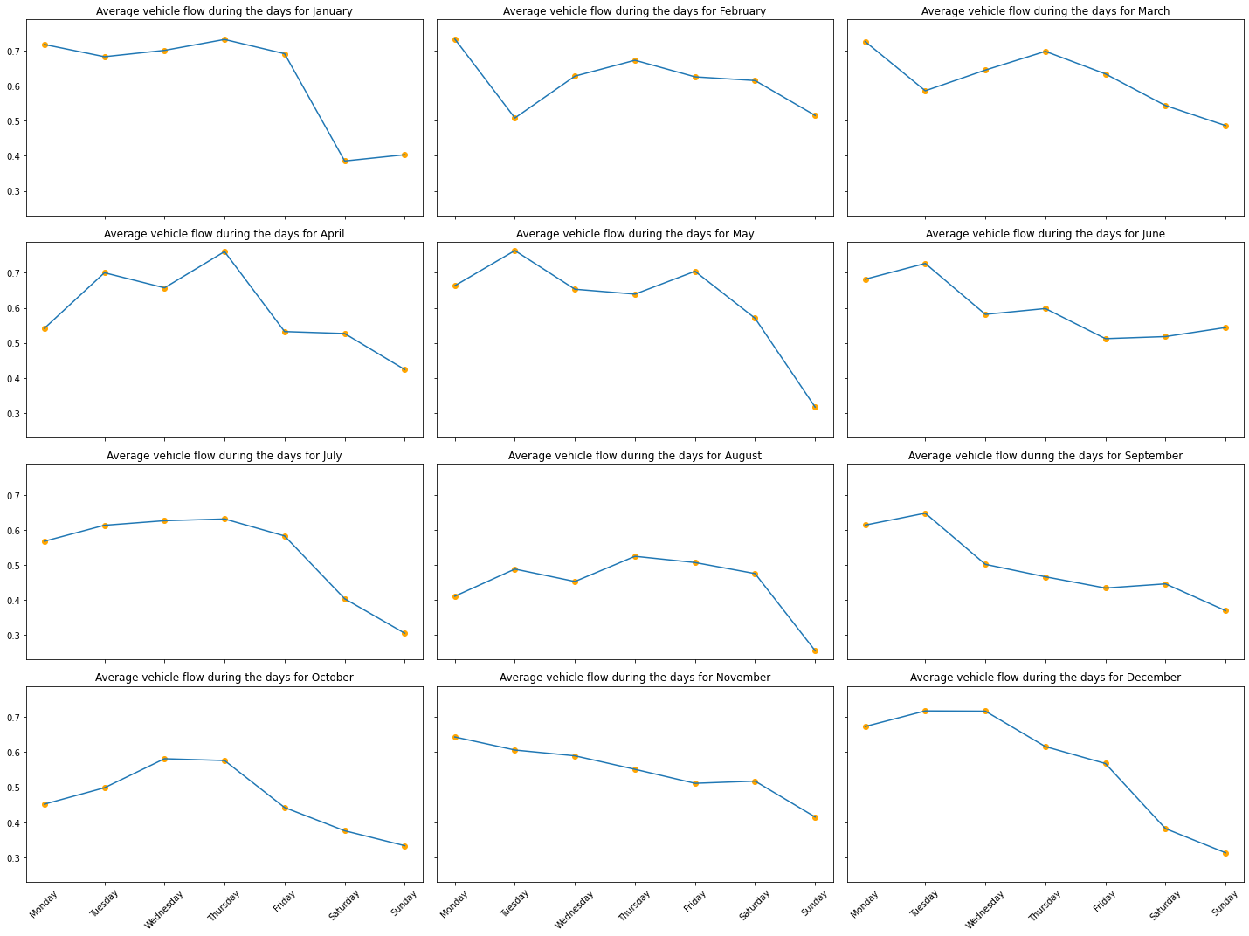
Average vehicle flow for different weekdays and different months

Slide 37
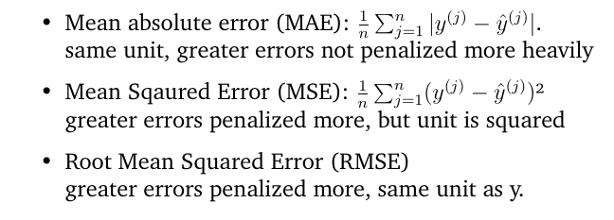
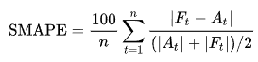
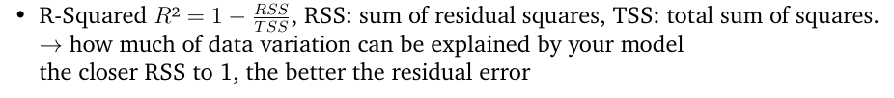
more detailed metrics for RandomForest, CatBoost and LightGBM
 | MAE (Mean Absolute Error) | MAE as percentage | MSE (Mean Squared Error) | RMSE (Root Mean Squared Error) | R² | SMAPE (Symmetric Mean Absolute Percentage Error)
Random Forest | 3.834 | 16.76 % | 60.10 | 7.75 | 0.94 | 102.21 %
CatBoost | 4.10 | 17.93 % | 60.27 | 7.76 | 0.94 | 102.72 %
LightGBM | 4.069 | 17.98 % | 63.28 | 7.95 | 0.94 | 102.72 %
percentage difference between observed and predicted values.
symmetric (over-and underestimation treated equally), sensitive to extreme outliers, produces infinite values if actual and predicted value are zero
Metrics sources: Data Science 1 course, https://mlpills.dev/time-series/error-metrics-for-time-series-forecasting/, https://sefidian.com/2022/08/18/a-guide-on-regression-error-metrics-with-python-code/

Slide 38
Random Forest Model
3 Stages :
Training Phase : Each tree is trained on a random subset of the training data (if bootstrap sampling is used) and at each split, a random subset of features is considered.
Prediction Phase : Input features are passed through all the trees in the forest. Each tree, based on its learned patterns, makes a prediction about the target variable.
Aggregation : Final prediction is calculated by averaging the predictions from all individual trees.
Hyperparameters tuned :
n_estimators : represents the number of trees in the forest
max_depth : maximum depth of each tree (deeper tree may overfit)
min_samples_split : minimum number of samples required to split an internal node
min_samples_leaf : minimum number of samples required to be at a leaf node
max_features : number of features to consider when looking for the best split (e.g., auto, sqrt, log2)
bootstrap : True or False (If False, the entire dataset is used to build each tree)
Tuning was done by evaluation on the basis of metrics in slide 19

Slide 39
Prophet, Random Forest, LigthGBM, CatBoost
Prophet:
additive time series forecasting model
Random Forest:
collection of many decision trees whose predictions are combined for a single prediction
each tree is trained independently by randomly selecting features and using a random subsampling (bootstrap) part of the dataset
Randomness helps to make the model more robust than a single decision tree, and less likely to overfit on the training data
Boosting techniques train a single tree using a sequence of underfit trees. There are different numbers of boosting methods.
LightGBM (Light Gradient Boosting Machine):
implements LightGBM algorithm
Uses Gradient-based One-Side Sampling (GOSS) that helps find the most influential cuts
only use instances with large gradients and cut the small gradients when sampling the dataset
Exclusive Feature Bundling (EFB). EFB reduces the number of features.
Grows trees by leaves -> can result in imbalance (asymmetric) trees.
CatBoost: also based on gradient boosting
optimized for categorical variables
Uses Ordered Boosting and ordered TS (Target Statistics)
minimal variance sampling (MVS) helps to maximize the accuracy of splits
ordering principal stops target leakage
grows trees by levels and results in balanced trees
https://medium.com/octave-john-keells-group/xgboost-light-gbm-and-catboost-a-comparison-of-decision-tree-algorithms-and-applications-to-a-f1d2d376d89c
https://colab.research.google.com/drive/1uCNP2h8mDb3cmiORc5b8mZ5bILFRIU6-?usp=sharing#scrollTo=pih-9yS6e5ga
https://medium.com/@veribilimi35/machine-learning-part-4-random-forest-gbm-xgboost-lightgbm-catboost-10e4e69eef33
https://machinelearningmastery.com/time-series-forecasting-with-prophet-in-python/
https://research.facebook.com/blog/2017/02/prophet-forecasting-at-scale/

